Slide 1
SI 501 F21: Week 4 Agenda
Discussion of readings
Introduction to interviewing
Interview protocols
Interviewing and note-taking
Observations

Slide 2
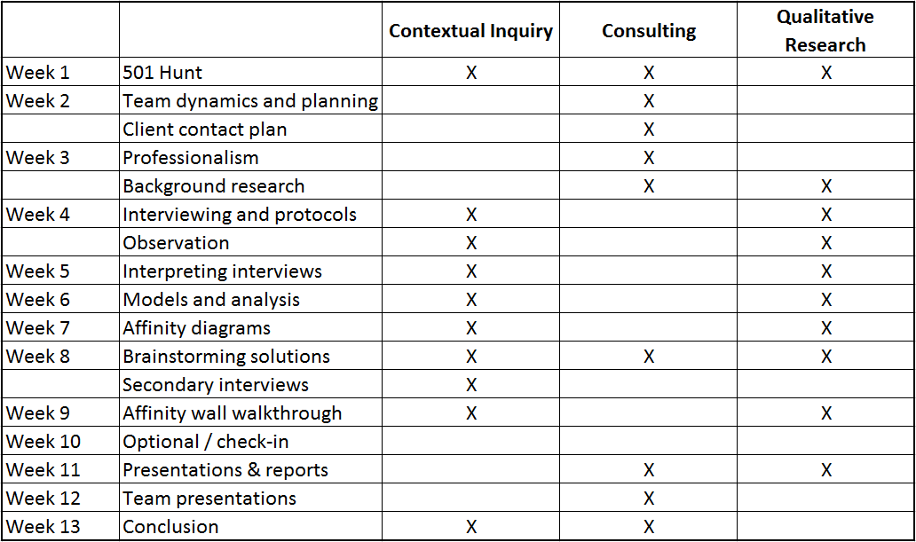
Course Overview

Slide 3
Discussion
How long should you plan for an interview and observation?
What attitude should you adopt when you conduct an interview?
What kind of responses do you want from your interviewees? How do you increase the likelihood of getting them?
How can you phrase questions when you’re asking about past events?
What does Weiss (1995) mean by a “marker”?
What challenges might you experience when conducting an interview? What can you do when an interview is going badly?
What ethical obligations do you have to the interviewee?
What did you find in the readings that was surprising or unexpected?
For this course, you will aim for 60-90 minutes.

Slide 4
Differences Between Readings and SI 501
Readings
SI 501
Give an introductory group talk.
Length of interview & observation: 2 hours
Interviews are conducted by one person doing interview and taking notes.
Give the interview participant a small gift.
No group talk.
Length of interview & observation: 60-90 minutes
Interviews are conducted by two people, with one doing interview and the other taking notes.
No gifts!

Slide 5
Differences Between In-Person and All-Virtual
In Person
All Virtual
Interviews happen in person, at the interviewee’s normal place of work.
Part of the interview involves an observation of the work as it happens.
Pen-and-pencil note-taking is encouraged, because screen can create a barrier with interviewee.
Interviews happen online (e.g., Zoom).
Conduct observation online if possible with shared screen.
Note-taking on laptop OK, though be careful to maintain eye contact as much as possible. (Pen-and-pencil still worth trying, though.) Note-taker should mute themselves most of the time.

Slide 6
How are client meetings going? Questions about Background Research Report? Any other questions?

Slide 7
Whom should you interview? When?
People involved directly with the problem or process in question. People who play 3 different job roles with respect to the problem. People who have a say with respect to the issue, as well as people affected by the issue. Best time for interviews is Oct. 11 – Oct. 29, but as early as Oct. 5 or as late as Nov. 5 is OK. This is because you want to have your interview protocol ready and also have time to do interpretations before we begin analysis with affinity walls.

Slide 8
Exercise 1 Form a group of 3-4 people – avoid team members. (Online people will be put into breakout rooms.) Introduce yourselves to each other before you start. Choose one person to be the interviewer. Choose another person to be the interviewee. The other people in the room should observe and take notes.
(Online students: Take a screen shot of this slide, so you have it when you go to breakout rooms.)
The interviewer should conduct an interview with the interviewee for 5 minutes. No further instructions!

Slide 9
Discussion
How did it feel as the interviewer?
As the interviewee?
What did observers observe?
What, if anything, felt strange or uncomfortable about the interview?
What could be done differently?

Slide 10
Exercise 2 Stay with the same group. Choose a different person to be the interviewer. Choose a different person to be the interviewee. Conduct another interview for 5 minutes. Take notes on pen and paper. Pick one of the topics below:
(Online students: Take a screen shot of this slide, so you have it when we go to breakout rooms.)
An embarrassing event that happened since the interviewee arrived at UMSI.
The class you’re taking now that the interviewee likes least (other than SI 501).
Someone the interviewee finds attractive, who is not a famous person.

Slide 11
Discussion
How did it feel as the interviewer?
As the interviewee?
What did observers observe?
What, if anything, felt strange or uncomfortable about the interview?
What could be done differently?

Slide 12
Interview Protocols
An interview protocol is a guideline for how you plan to conduct an interview.
It will contain an introduction, a set of questions, and a conclusion.
Introduction: interview goals and content, interview duration, confidentiality, voluntary nature, audio recording permission, etc.
Key questions + follow-up questions: for each interviewee (or interviewee type), a set of carefully crafted and organized questions.
Conclusion: interviewee questions, contact information, follow-up after interview, thank yous, etc.
In contextual inquiry, we conduct semi-structured interviews, so the set of questions are only guidelines. You will deviate frequently from the protocol to follow up interesting leads, and to otherwise adjust based on the responses. You will generally not ask the protocol questions one after the other. However, the protocol will be useful as a guide for you, and as a safety net of questions, in case you need it.

Slide 13
Exercise 3 On your own, develop a series of key questions that would form the core of an interview protocol. (For now, don’t worry about the introduction or the conclusion.) The interview goal is to understand instances when the interviewee (the person being interviewed) had difficulty figuring out how to use a website or a smartphone app, and how they responded to those instances. Do this silently and on your own. You have 5 minutes.
(Online students: Take a screen shot of this slide, so you have it when we go to breakout rooms.)

Slide 14
Discussion
What questions did you include?
What kinds of responses do you think they would elicit?
Did you think about how the questions should be worded so as to encourage more revealing or interesting responses?
Did you think about the ordering of the questions and if so,
how did you organize them?

Slide 15
Interview Protocol Guidelines
Have an overarching question in mind. Write it out explicitly.
Create a list of key questions.
Cluster them by theme.
Think through the ordering of themes and the ordering of questions within themes.
Include follow-up questions for each key question, to dig deeper, or to ensure that you get the responses you need.
Consider how best to ask the participant to re-enact an experience from the past.
Most questions should…
Be relevant for answering the main question;
Be mostly open-ended;
Be non-judgmental;
Be phrased to avoid sounding like they are attacking or evaluating the participant;
Elicit concrete responses, and not abstract generalizations (e.g., “Could you tell me about the last time when…?”);
Avoid leading the participant into thinking that you are looking for a particular answer;
Show that you are adopting the stance of a learner / apprentice.

Slide 16
The First Rule of Strategic Thinking
Whatever it is that you’re doing, be clear about the main goal of the activity.
If unsure of main goal, take time to figure it out.
Without a main goal, any further effort might not be worth it.
You can only have one main goal.
If you think you have two or more goals, ask yourself which one is the most important to you. Sometimes, two or more goals can be merged and restated as a single, larger goal.
Main goals can nest within one another (i.e., goals can have subgoals). In such a situation, choose the right level goal to focus on.
Make decisions based on your main goal. Use your main goal to prioritize.
In some cases, you may have hard constraints (e.g., ethical or legal) that take precedence over your main goal.
You can have (non-hard-constraint) secondary goals. But, whenever your main goal and any secondary goals are in competition, choose in favor of your main goal.

Slide 17
Interview Protocol Guidelines
Have an overarching question in mind. Write it out explicitly.
Create a list of key questions.
Cluster them by theme.
Think through the ordering of themes and the ordering of questions within themes.
Include follow-up questions for each key question, to dig deeper, or to ensure that you get the responses you need.
Consider how best to ask the participant to re-enact an experience from the past.
Most questions should…
Be relevant for answering the main question;
Be mostly open-ended;
Be non-judgmental;
Be phrased to avoid sounding like they are attacking or evaluating the participant;
Elicit concrete responses, and not abstract generalizations (e.g., “Could you tell me about the last time when…?”);
Avoid leading the participant into thinking that you are looking for a particular answer;
Show that you are adopting the stance of a learner / apprentice.

Slide 18
Interview Protocol Guidelines
Have an overarching question in mind. Write it out explicitly.
Create a list of key questions.
Cluster them by theme.
Think through the ordering of themes and the ordering of questions within themes.
Include follow-up questions for each key question, to dig deeper, or to ensure that you get the responses you need.
Consider how best to ask the participant to re-enact an experience from the past.
Most questions should…
Be relevant for answering the main question;
Be mostly open-ended;
Be non-judgmental;
Be phrased to avoid sounding like they are attacking or evaluating the participant;
Elicit concrete responses, and not abstract generalizations (e.g., “Could you tell me about the last time when…?”);
Avoid leading the participant into thinking that you are looking for a particular answer;
Show that you are adopting the stance of a learner / apprentice.

Slide 19
Interview Protocol Guidelines
Have an overarching question in mind. Write it out explicitly.
Create a list of key questions.
Cluster them by theme.
Think through the ordering of themes and the ordering of questions within themes.
Include follow-up questions for each key question, to dig deeper, or to ensure that you get the responses you need.
Consider how best to ask the participant to re-enact an experience from the past.
Most questions should…
Be relevant for answering the main question;
Be mostly open-ended;
Be non-judgmental;
Be phrased to avoid sounding like they are attacking or evaluating the participant;
Elicit concrete responses, and not abstract generalizations (e.g., “Could you tell me about the last time when…?”);
Avoid leading the participant into thinking that you are looking for a particular answer;
Show that you are adopting the stance of a learner / apprentice.

Slide 20
Exercise 4 Revise and re-organize your series of questions from the previous exercise with your group. Make sure you have a good overarching question. You’ll have ~7 minutes. Again: The interview goal is to understand specific instances when the interviewee (the person being interviewed) had difficulty figuring out how to use a website or a smartphone app, and how they responded to those instances.
Guidelines:
Write out an overarching question explicitly.
List the key questions. These should…
Be relevant for answering the main question;
Be mostly open-ended;
Be non-judgmental;
Be phrased to avoid sounding like they are attacking or evaluating the participant;
Elicit concrete responses, and not abstract generalizations (e.g., “Could you tell me about the last time when…?”);
Avoid leading the participant into thinking that you are looking for a particular answer;
Show that you are adopting the stance of a learner / apprentice.
Add follow-up questions. (These can bend the guidelines above somewhat.)
Cluster and organize the key questions in some logical order.
(Online students: Take a screen shot of this slide, so you have it when we go to breakout rooms.)

Slide 21
Discussion
What kinds of changes did you make?
What kinds of changes were difficult to make, if any?
Any questions about generating good questions for an interview protocol?

Slide 22
Exercise 5 Breakout rooms again. Pick someone to be interviewer; another person to be interviewee; others will be note-takers. Conduct an interview, using the protocol questions as a guideline. You have 7 minutes. Note-takers: You will need to share your notes with everyone else in the breakout room after these exercises are over. Please make sure you have emails of all group members, and that you take good notes!
(Online students: Take a screen shot of this slide, so you have it when we go to breakout rooms.)

Slide 23
Discussion
How did the interviews go?
How did having an interview protocol affect your interview,
especially compared with the first interviews you did today?
What kind of challenges did you face in the interview?
Were you able to get satisfactory answers to the overarching question?

Slide 24
Exercise 6 Find a new partner who is not in your team. (Or, form a group of 3.)
(Online students: Take a screen shot of this slide, so you have it when we go to breakout rooms.)
Decide which of you will observe the other. The person being observed should work on an assignment they have to do for another class.
(Online students: Do this on Shared Screen.) The observer should silently take notes, trying to capture the way the observed person goes about their work. No further instructions!

Slide 25
Discussion
How did it feel as the observer?
As the observed person?
If you were the observer, what kind of notes did you take?
What, if anything, felt strange or bad about the observation?
What could you do differently?

Slide 26
Exercise 7 Swap / rotate roles. The person being observed should work on an assignment they have to do for another class, but this time, talk through what they are doing as they are doing it. The observer should take notes, but this time, the observer should feel free to ask questions during the observation, to better understand what the observed person is doing, and why they are doing it.
(Online students: Take a screen shot of this slide, so you have it when we go to breakout rooms.)

Slide 27
Discussion
How did this feel in comparison to the previous observation exercise?
What was worse?
What was better?
What could you do differently?

Slide 28
For next week (Oct. 4)
Interview protocol assignments due! Carefully read the assignment and sample protocol in Canvas. There are components to a complete interview protocol that were not practiced explicitly in class.
Submit any work you have done toward your Background Research Report. Recommendation is to add an outline and/or a few hundred words.
Carry on with client meetings, set up interviews and observations if possible. Best time for interviews is Oct. 11 – Oct. 29, but as early as Oct. 5 or as late as Nov. 5 is OK.
No readings for next week; that also means no quiz. Yay!
Please come to next week’s class with all of your interview notes from today; everyone in each group should have the notes taken during in their group (even if someone else took the notes).

Slide 29
In Discussion Section
Ask your GSI, if you have any questions about client meetings, Background Research Report, or interview protocols.
Start working on your interview protocols. Read the Interview Protocol Assignment instructions carefully. Discuss with your team.

